Slide 1

Windows Server & Hyper-V Containers
Vaggelis Kappas

Slide 2
What is a container?

Slide 3
What is a container?
Application
OS
Hardware

Slide 4
What is a container?
Traditional virtual machines = hardware virtualization
Application
VM
VM
VM
OS
Hardware

Slide 5
What is a container?
Traditional virtual machines = hardware virtualization
Application
VM
VM
VM
OS
Hardware

Slide 6
What is a container?
OS
Hardware
Traditional virtual machines = hardware virtualization
Application
VM
VM
VM
OS
Hardware

Slide 7
What is a container?
Containers = Operating system virtualization
OS
Applications
Kernel
Hardware
Traditional virtual machines = hardware virtualization
Application
VM
VM
VM
OS
Hardware

Slide 8
What is a container?
Containers = Operating system virtualization
OS
CONTAINER
CONTAINER
CONTAINER
Applications
Kernel
Hardware
Traditional virtual machines = hardware virtualization
Application
VM
VM
VM
OS
Hardware

Slide 9
What is a container?
Containers = Operating system virtualization
OS
CONTAINER
CONTAINER
CONTAINER
Applications
Kernel
Hardware
Traditional virtual machines = hardware virtualization
Application
VM
VM
VM
OS
Hardware

Slide 10
What is a container?
Containers = Operating system virtualization
Windows Server Containers
Maximum speed and density
OS
CONTAINER
CONTAINER
CONTAINER
CONTAINER
CONTAINER
CONTAINER
Applications
Kernel
Kernel
Hardware
Traditional virtual machines = hardware virtualization
Application
VM
VM
VM
OS
Hardware

Slide 11
What is a container?
Containers = Operating system virtualization
Windows Server Containers
Maximum speed and density
OS
CONTAINER
CONTAINER
CONTAINER
CONTAINER
CONTAINER
CONTAINER
Applications
Kernel
Kernel
Hardware
Hyper-V Containers
Isolation plus performance
Traditional virtual machines = hardware virtualization
Application
VM
VM
VM
CONTAINER
CONTAINER
CONTAINER
OS
Kernel
Kernel
Kernel
Hardware
Hyper-V

Slide 12
How do containers work?

Slide 13
High Level Architecture
}
Docker
Universal Control Plane
Container
Development and
Management Toolset
Docker
Client
Docker PowerShell
Docker Compose
Docker
Registry
Docker Swarm
Docker Engine
Operating System
Container Runtime

Slide 14
Windows Containers
Host User Mode
System Processes
Container Management
Session Manager
Docker Engine
Local Security Authority
Compute Services
Etc…
Windows Kernel
Hyper-V Hypervisor

Slide 15
Windows Containers
Host User Mode
System Processes
Container Management
Session Manager
Docker Engine
Local Security Authority
Windows Server Container
Compute Services
Etc…
Windows Kernel
Hyper-V Hypervisor

Slide 16
Windows Containers
Host User Mode
System Processes
Container Management
Session Manager
Docker Engine
Local Security Authority
Windows Server Container
Compute Services
Etc…
System Processes
Windows Kernel
Hyper-V Hypervisor

Slide 17
Windows Containers
Host User Mode
System Processes
Container Management
Session Manager
Docker Engine
Local Security Authority
Windows Server Container
Compute Services
Etc…
System Processes
Application Process(es)
Windows Kernel
Hyper-V Hypervisor

Slide 18
Windows Containers
Host User Mode
System Processes
Container Management
Session Manager
Docker Engine
Windows Server Container
Local Security Authority
Windows Server Container
Compute Services
System Processes
System Processes
Application Process(es)
Etc…
Application Process(es)
Windows Kernel
Hyper-V Hypervisor

Slide 19
Windows Containers
Host User Mode
System Processes
Container Management
Session Manager
Hyper-V Container
Docker Engine
Windows Server Container
Local Security Authority
Windows Server Container
Compute Services
System Processes
System Processes
Application Process(es)
Etc…
Application Process(es)
Windows Kernel
Hyper-V Hypervisor

Slide 20
Windows Containers
Host User Mode
System Processes
Container Management
Session Manager
Hyper-V Container
Docker Engine
Windows Server Container
Local Security Authority
Windows Server Container
Compute Services
System Processes
System Processes
Application Process(es)
Etc…
Application Process(es)
Windows Kernel
Windows Kernel
Hyper-V Hypervisor

Slide 21
Windows Containers
Host User Mode
System Processes
Container Management
Session Manager
Hyper-V Container
Docker Engine
Local Security Authority
Windows Server Container
Windows Server Container
Compute Services
Etc…
System Processes
Application Process(es)
System Processes
Application Process(es)
Windows Kernel
Windows Kernel
Hyper-V Hypervisor

Slide 22
Windows Containers
Host User Mode
Virtual Machine
Specifically Optimized To Run a Container
System Processes
Container Management
Session Manager
Hyper-V Container
Docker Engine
Local Security Authority
Windows Server Container
Windows Server Container
Compute Services
Etc…
System Processes
Application Process(es)
System Processes
Application Process(es)
Windows Kernel
Windows Kernel
Hyper-V Hypervisor

Slide 23
Startup Performance
NodeJS with Nano Server
NodeJS with Windows Server Core
Hyper-V Container
~1.75 seconds
Windows Server Container
Under 600 Milliseconds!
Hyper-V Container
~3.3 seconds
Windows Server Container
~1 second
A virtual machine takes ~3 seconds
A virtual machine takes ~5 seconds to over a min
*Includes initial boot provisioning phase (out-of-box setup etc…)
**Startup time after initial container start.
Testing performed on HP ProLiant SL250s Gen8, E5-2600, 2 Socket, 8 Core, 128GB RAM, HP SATA SSD - results may vary based on hardware and software configurations.

Slide 24
Startup Performance
NodeJS with Nano Server
Windows Server Container
Under 600 Milliseconds!
Hyper-V Container
~1.75 seconds
A virtual machine takes ~3 seconds
NodeJS with Windows Server Core
Windows Server Container
~1 second
Hyper-V Container
~3.3 seconds
A virtual machine takes ~5 seconds to over a min

Slide 25
Density
NodeJS with Nano Server
NodeJS with Windows Server Core
Hyper-V Container
First Container ~340MB
Additional Containers ~150MB
Windows Server Container
First Container ~120MB
Additional Containers ~75MB
Hyper-V Container
First Container ~555MB
Additional Containers ~280MB
Windows Server Container
First Container ~150MB
Additional Containers ~75MB
Testing performed on HP ProLiant SL250s Gen8, E5-2600, 2 Socket, 8 Core, 128GB RAM, HP SATA SSD - results may vary based on hardware and software configurations.

Slide 26
Density
NodeJS with Nano Server
Windows Server Container
First Container ~120MB
Additional Containers ~75MB
Hyper-V Container
First Container ~340MB
Additional Containers ~150MB
NodeJS with Windows Server Core
Windows Server Container
First Container ~150MB
Additional Containers ~75MB
Hyper-V Container
First Container ~555MB
Additional Containers ~280MB

Slide 27
How do I create a container?

Slide 28
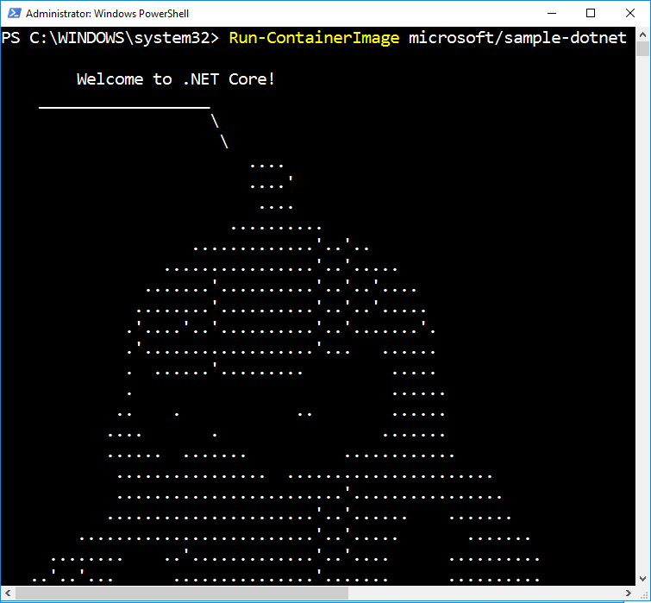
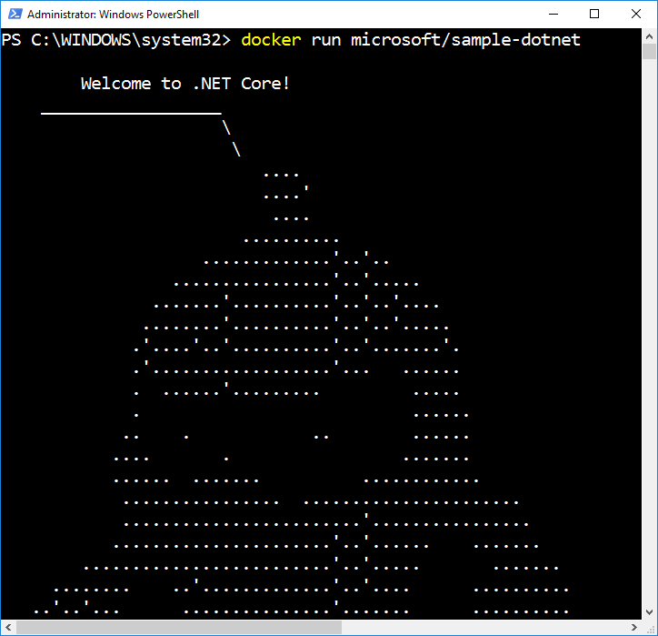
Docker Run
Creates and Starts a New Container
  Runtime options
    Name (network name and management name)
    Interactive or Service
    Network configuration
    Resource management
    Volume mappings
    Isolation level

Slide 29
Demo creating a container

Slide 30
What is a container image?

Slide 31

Container Image
  Analogous to a VHD and config file to a virtual machine
  Created by running a container and capturing changes
  Changes include files and registry
Image
Metadata
Name,
Creation Data,
Command To Execute,
Dependences
Contents
Registry
Files
Folders

Slide 32
Container Images
My Website
Application
IIS
Application Framework
Base Image (OS)

Slide 33
Container Images
My Website
Application
IIS
Application Framework
Image Contents
Registry
Folders and Files
HKLM
HKCU
License.txt
PerfLogs
Program Files
Base Image (OS)
HKCR
HKU
Program Files (x86)
Users
Windows

Slide 34
Container Images
Image Contents
Registry
Folders and Files
My Website
Application
HKLM
inetpub
mysite.html
IIS
SOFTWARE/mykey
Application Framework
Image Contents
Registry
Folders and Files
HKLM
HKCU
License.txt
PerfLogs
Program Files
Base Image (OS)
HKCR
HKU
Program Files (x86)
Users
Windows

Slide 35
Automated Image Building
Docker Build and Dockerfiles
  Method for automated container image build
  Consumed when running “docker build”
  Caches unchanged commands
  Integrates into Docker Hub
Examples
  IIS
    FROM microsoft/windowsservercore
    RUN powershell –command Add-WindowsFeature Web-Server
  Website
    FROM iis
    ADD mysite.htm inetpub\mysite.htm
My Website
IIS

Slide 36
Image Registries
What is a registry?
  Stores container images
    Images are Pushed into a registry
    Images are Pulled from a registry
    Images are Searched for within a registry

Slide 37
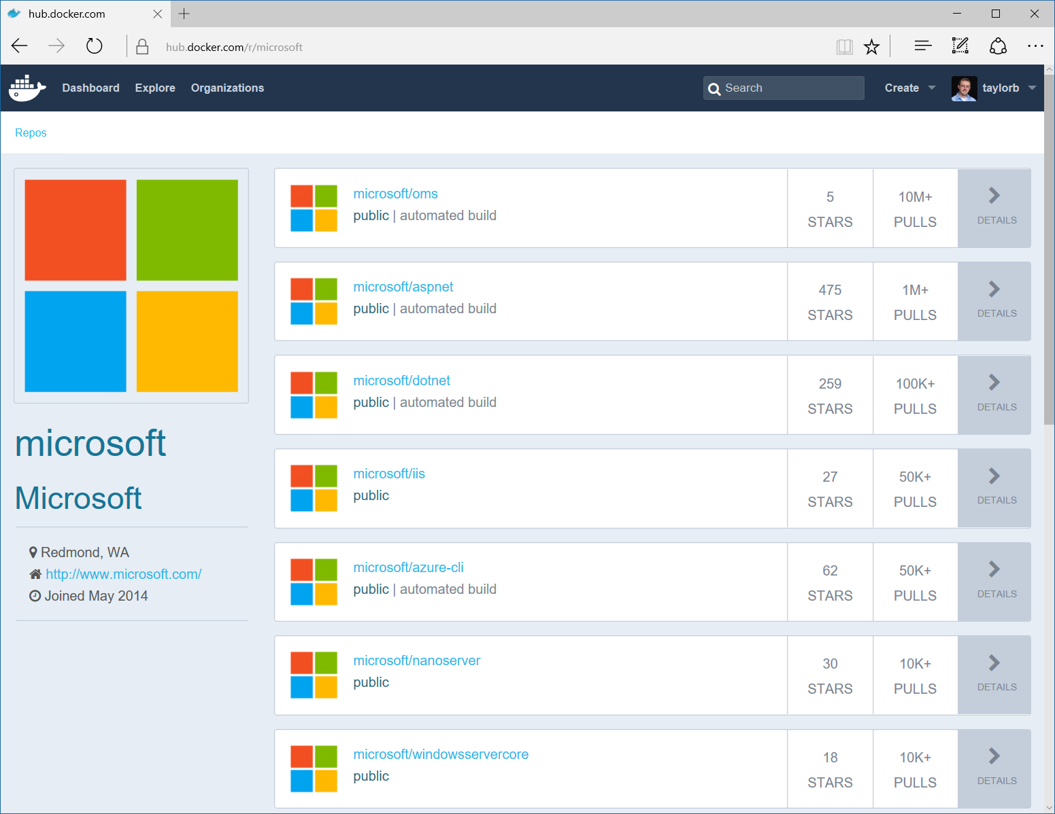
Image Registries
Docker Hub and Docker Store
  Public, Official and Private image repositories
  Granular access controls with organization support
  Automated image build support
Docker Trusted Registry
  Enterprise Grade Private Registries
  Runs on your infrastructure (on-prem or cloud)
  Active Directory and Role Based Access Controls
Docker Registry
  Open source foundation of Hub and DTR
  Runs on your infrastructure (on-prem or cloud) as a container
  https://docs.docker.com/registry and or https://github.com/docker/distribution

Slide 38
Demo building a container image

